Slide 1
Agile @ Microsoft How we built a DevOps culture and process
Ewald Hofman
Senior Program Manager
Microsoft
E-mail: Ewald.Hofman@microsoft.com
Twitter: @VSTeam
Survey: http://aka.ms/vstsmeetups

Slide 2
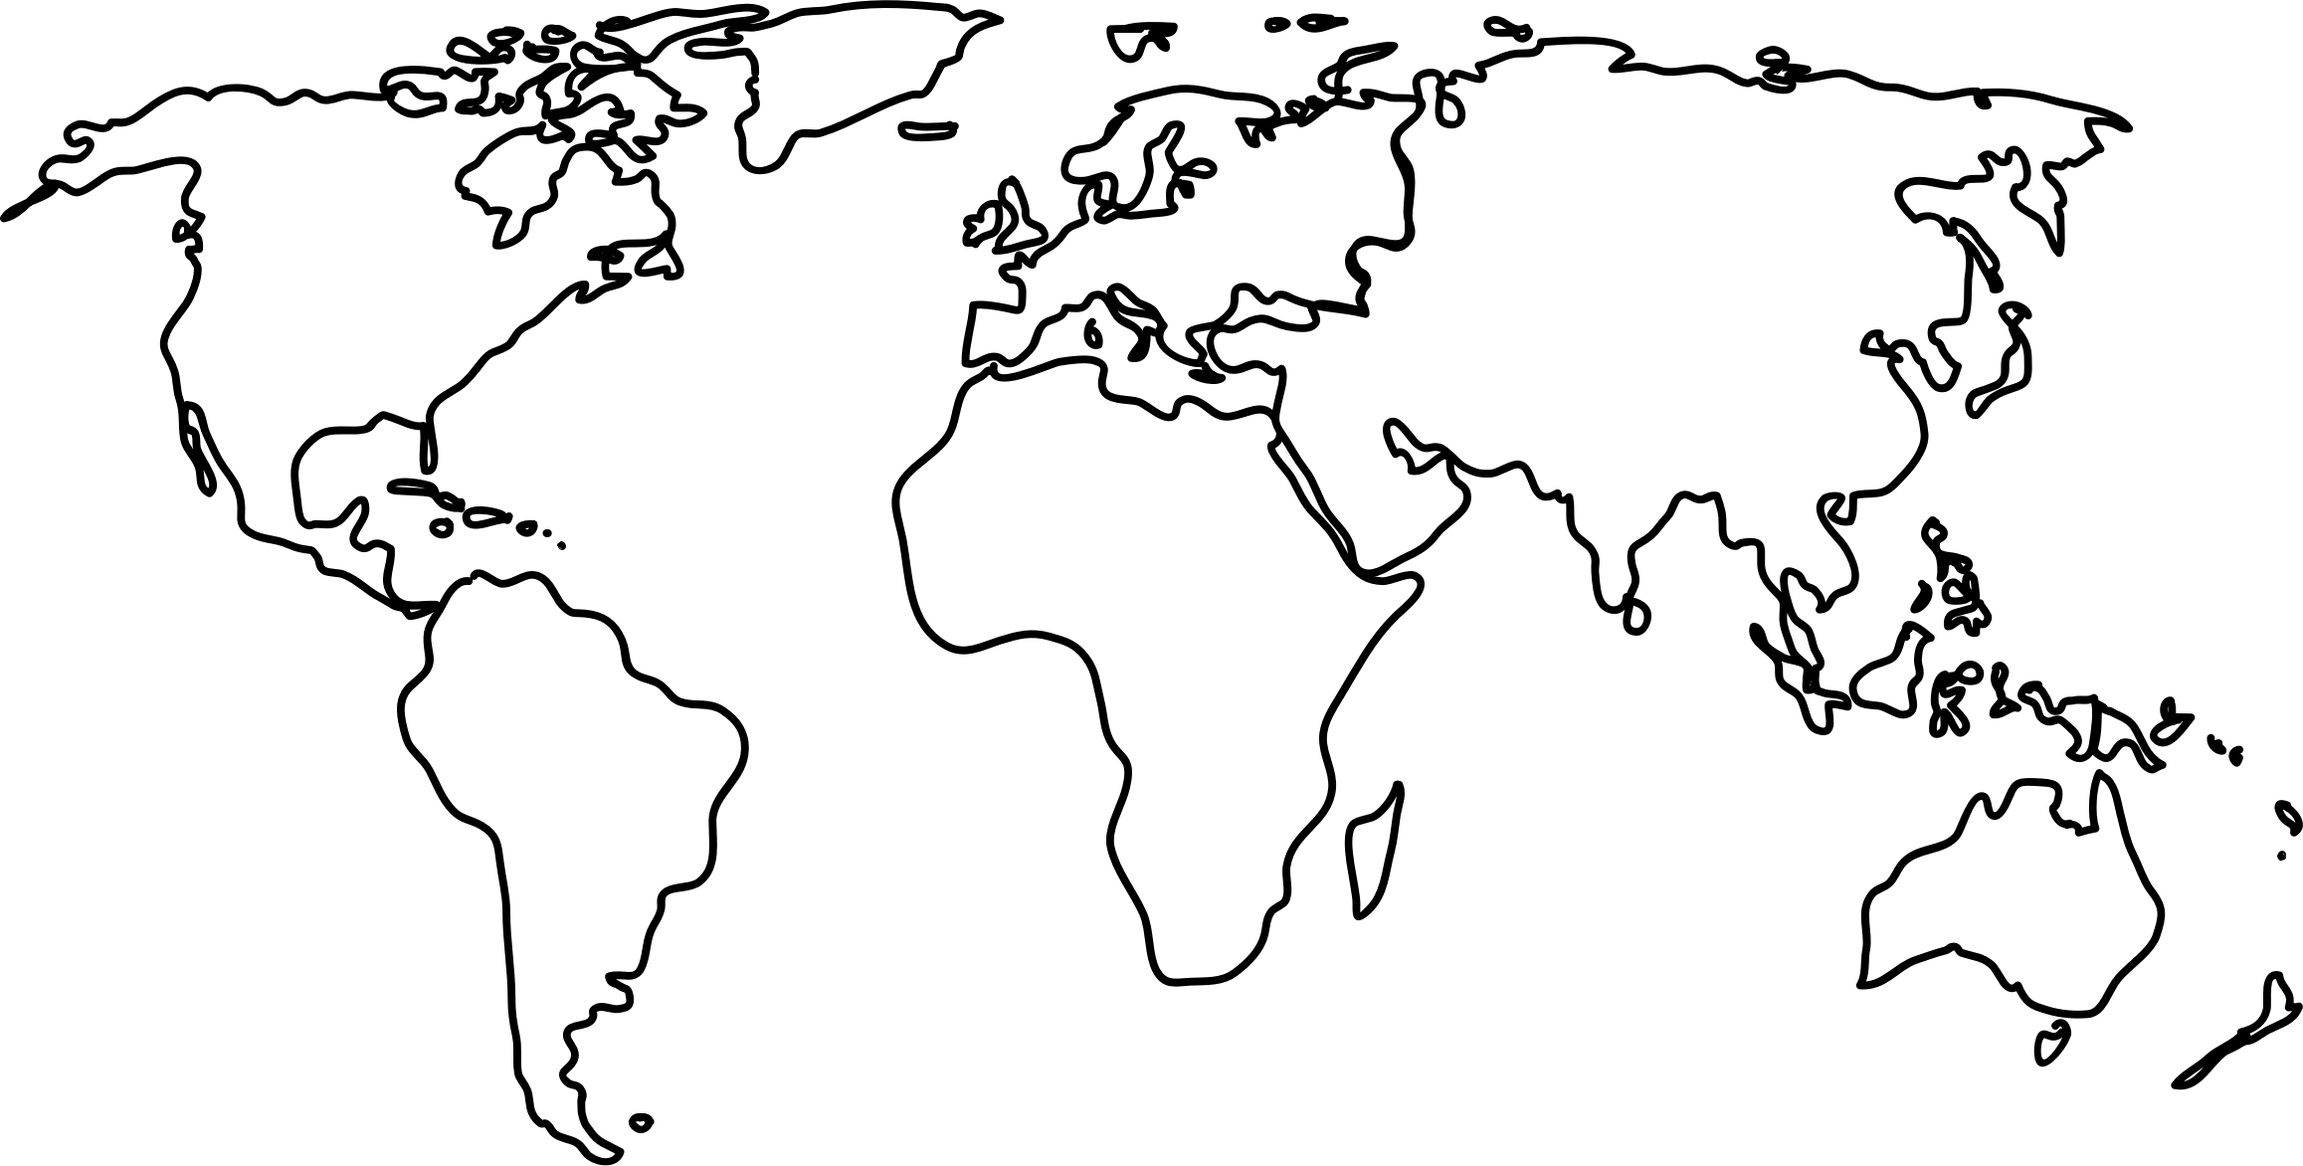
Developer Division at Microsoft
4,307
4300+ people
430+ in Team Services
35 feature teams
3 major geographic locations

Slide 3
Planning
The OLD way
We knew exactly what to build, and we knew it was right!
Specs
Specs
Specs
Planning
M1
M2

Slide 4
Phases
The OLD way
We had a perfect schedule and knew exactly when it would be ready!
Beta
RTM
Code
Test & Stabilize
Code
Test & Stabilize

Slide 5
Code Flow
The OLD way
Code
Complete
We wrote all the code months before we shipped.
Code
Test & Stabilize
Code
Test & Stabilize

Slide 6
Feedback
The OLD way
Customer feedback – we should change the way a feature works. We didn’t get it quite right…
Planning
… but we’re booked solid already.

Slide 7
Feedback
The OLD way
“Great feedback. Thanks! We’ll take a look in planning for the next release. We should get it to you….
in a few years.”

Slide 8
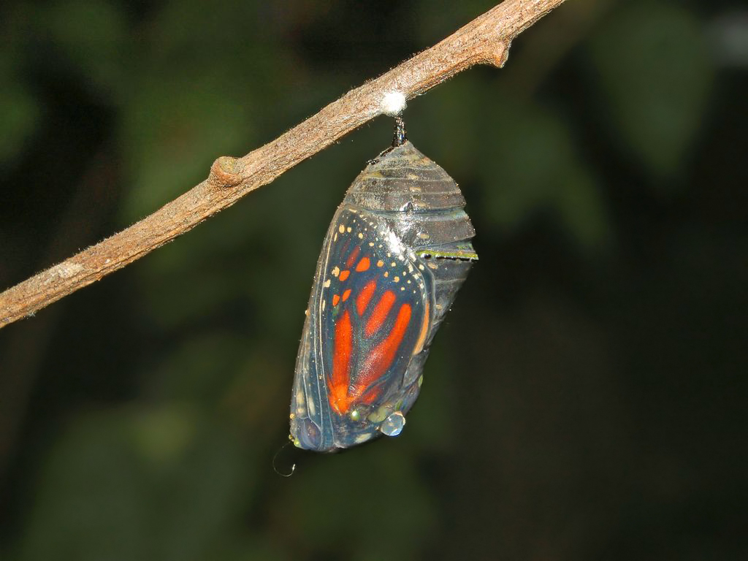
How do we transform our culture?
Notes:
https://upload.wikimedia.org/wikipedia/commons/6/6d/Nymphalidae_-_Danaus_plexippus_Chrysalis-1.JPG

Slide 9
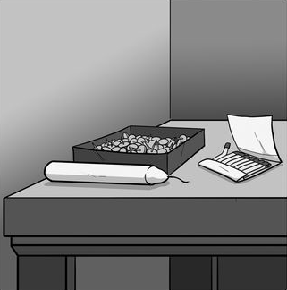
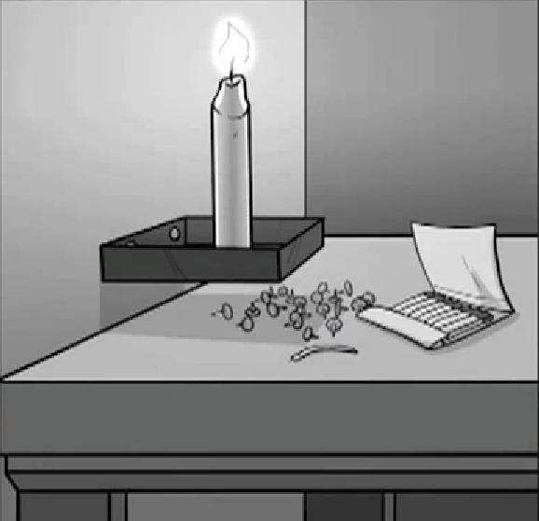
Culture
“There is a mismatch between what science knows and what business does.”
“for even the most rudimentary cognitive skills, a larger reward led to poorer performance”

Slide 10

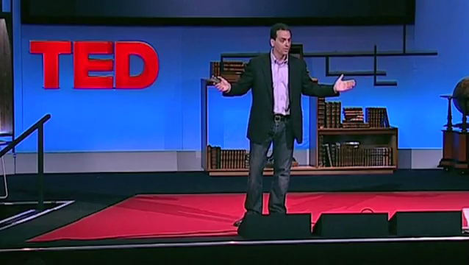
Dan Pink
“Let’s try to give our teams three things…. Autonomy, Mastery, Purpose”
http://aka.ms/danpink [18:36]

Slide 11
Guiding Principles
Organization
Roles
Teams
Taxonomy
Cadence
Plan
Practices
Alignment
Autonomy

Slide 12
Roles
The OLD way
Program Management
Dev
Test

Slide 13
Combined Engineering
Program Management
Engineering

Slide 14
Teams
Program Management
Engineering
Cross-discipline
8-12 people
Intact for 12-18 months
Autonomous backlog

Slide 15
Autonomy & Responsibility
Tech
Writers
Program
Management
UX
Engineering
Operations

Slide 16
Autonomy & Responsibility
Tech
Writers
Program
Management
UX
Engineering
Operations

Slide 17
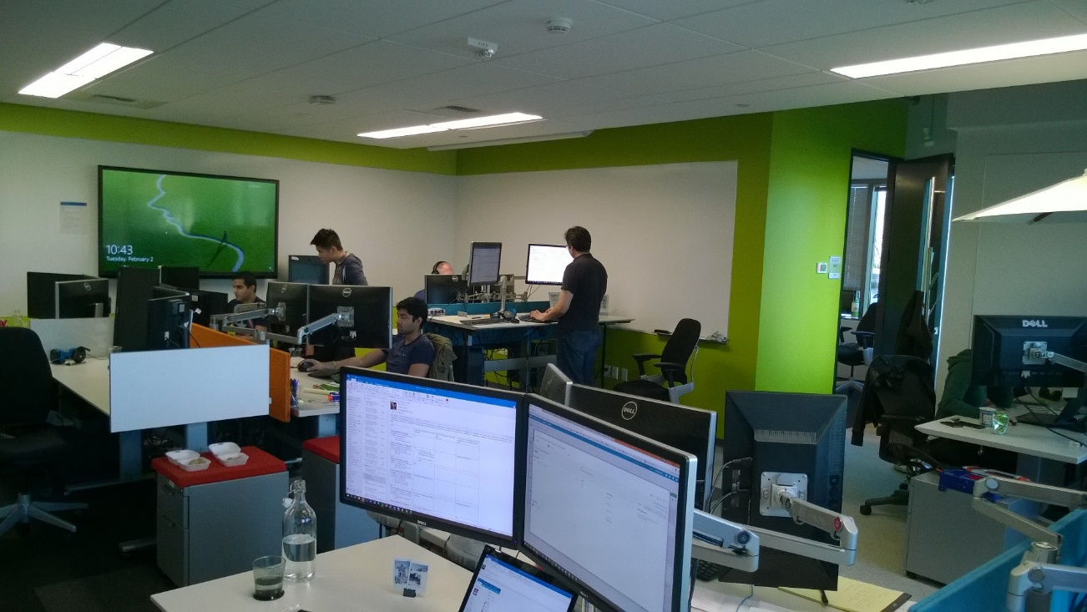
Team rooms

Slide 18
Teams
UI
API
Data

Slide 19
Instead of horizontal…
UI
API
Data

Slide 20
We strive for vertical
UI
API
Data
Platform

Slide 21

How do we stay aligned?
Notes:
Flickr Creative Commons
https://www.flickr.com/photos/colinsd40/6201031303/in/photolist-arXUyP-7EQZS9-dbqthE-hm3FAp-hm2rUb-hm27Sx-hm2ysu-hm1WPX-hm3rnz-hm3o8Z-hm3jPp-hm2ffY-hm3eTc-hm2ce7-hm1Fb2-6WZihk-hm3ctT-hm2a9A-hm342n-kGEvA-ai87qS-a9VPbp-5FBa4h-8Dfw7w-a9YBHJ-a9YBsA-a9VNok-a9VMWD-5JnSjE-ngFdUH-7AEPev-8TGoo8-7AEPb6-7AJzFA-7AEP6K-7AJzz1-7AJzvy-7AENh2-7AENf8-7AENdx-7AENbn-7AJyEY-7AEN6T-7AEN5a-7AJyzG-7AEN1t-7AJywm-7AEMWi-7AJys5-7AJyqf

Slide 22
Cadence
The OLD way
Release
Cloud Services
1 2 3 4 5 6
Visual Studio
A B C D E
Partner team
I II III IV V VI VII VII IX

Slide 23
Aligned cadence
Release
Cloud Services
1 2 3 4 5 6
Visual Studio
1 2 3 4 5 6
Partner team
1 2 3 4 5 6

Slide 24
Story: Sprint 1-5
Take Two
S1
S2
B
S3
S4
S5
A
S1
S2
S3
S4
S5
Stabilization
S6

Slide 25


Release more frequent
Team Foundation Server
stabilization
Visual Studio
Team Services
3 weeks

Slide 26
Taxonomy
Scenarios
Features
Tasks
Stories
Alignment
Every team and business tracks scenarios and features consistently.
Autonomy
Every team chooses how to manage stories and/or tasks

Slide 27
Staying Aligned
Aspirational
60%
Sprint
3 week
Plan
3 sprint
Season
6 month
Scenario
18 month
6
18
3
3
6
18
Spring
Fall
Spring
Fall

Slide 28
Staying Aligned
Hopeful
80%
Sprint
3 week
Plan
3 sprint
Season
6 month
Scenario
18 month
6
18
3
3
6
18
Spring
Fall
Spring
Fall

Slide 29
Staying Aligned
Thoughtful
90%
Sprint
3 week
Plan
3 sprint
Season
6 month
Scenario
18 month
6
18
3
3
6
18
Spring
Fall
Spring
Fall

Slide 30
Staying Aligned
Confident
95%
Sprint
3 week
Plan
3 sprint
Season
6 month
Scenario
18 month
6
18
3
3
6
18
Spring
Fall
Spring
Fall

Slide 31
3 week sprints
Deployment
Sprint Planning
Bug bash
Done!
Week 1
Week 2
Week 3
Sprint 99
Sprint 100
Sprint 101
Week 1
Week 2
Week 3
Week 1
Week 2
Week 3

Slide 32
3 week sprints
The sprint plan
What we accomplished
Week 1
Week 2
Week 3
Sprint 99
Sprint 100
Sprint 101
Week 1
Week 2
Week 3
Week 1
Week 2
Week 3

Slide 33

Engineering practices
Notes:
https://www.flickr.com/photos/regnatarajan/9119415436/in/photolist-eTRouC-dTfLPj-dgaxLQ-rL74Ry-kVAoJn-8F74L9-mGfW84-5Kxvus-dPKPGk-7bQskE-56xHqZ-hWovXf-8EQBvC-9UxT1B-82oozA-dYbgcC-dfNrvP-i5vaK-aBHVLL-7N9CUA-8EQHJf-oMcHub-peFDwd-uBve7i-mEpMn4-7RX1A6-7PkWzY-6qxvZM-a2Vxw6-6whJBT-8jWiEx-6jANtf-4TMWx3-6XMQds-bFSnGx-p9iCd-6qhBmX-xHUA8u-EqFATq-7bvc3k-o9w1rX-4ZJha4-5BTpFy-eomUyM-5BP6yK-5BP6o6-5BP8gT-a877s-baMxbP-cEpAsu

Slide 34
Everyone creates a branch…
The OLD way
Week 1
Week 2
Week 3

Slide 35
Writes a lot of code…
The OLD way
Week 1
Week 2
Week 3

Slide 36
It needs to come together…
The OLD way
Week 1
Week 2
Week 3

Slide 37

The OLD way
Week 1
Week 2
Week 3

Slide 38
Everyone is on ONE main master branch. How do we manage?

Slide 39
Feature Flags

Slide 40
Feature Flags
ON
OFF

Slide 41
Feature Flags
ON
OFF

Slide 42
Feature Flags
ON
OFF

Slide 43
Feature Flags
ON
OFF

Slide 44
Feature Flags

Slide 45
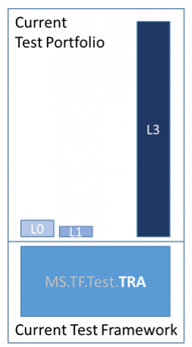
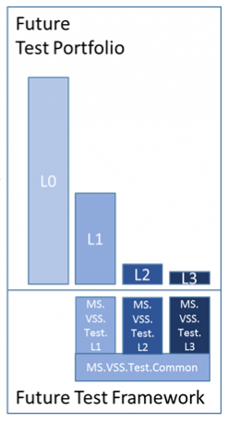
Test at the lowest possible level
Principles Tests should be written at the lowest level possible Write once, run anywhere - includes production system Product is designed for testability Test code is product code, only reliable tests survive Testing infrastructure is a shared service
Old
Current

Slide 46

How do we become predictable?
Notes:
https://fabiusmaximus.files.wordpress.com/2013/08/20130827-crystal-ball.jpg

Slide 47
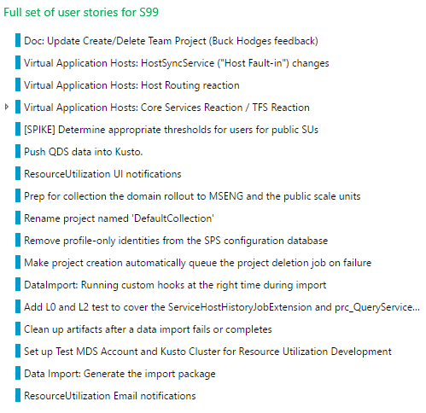
Plan
Reality

Slide 48
Execution
Plan
Reality
Feedback, bugs
Incidents

Slide 49




Why are we not predictable?
Context switching
Did not plan for incidents
Late feedback
Non-shared goals

Slide 50


Improved team
Feature work




Shielding
Account for incidents
Early feedback
Increase quality
Improve engineering system
Spread knowledge





Slide 51

There is no place like production

Slide 52

Staged deployment
Ring 0
Ring 1
Ring 2
Ring 3
SU0
SU5
SU1
SU2
SU6
SU3
SU7
SU6
AT
AT
AT
AT
AT
AT
AT
AT
AT
AT
AT
AT
AT
AT
AT
AT
AT
AT
AT
AT
AT
AT
AT
AT





Slide 53
Staged feature rollout
SU 0
SU 1
SU 2
SU 3

Slide 54
Canary
SU 0
SU 1
SU 2
SU 3
Validate in production

Slide 55
Early adopters
SU 0
SU 1
SU 2
SU 3
Only for larger features
Feature not completely ready
Get early feedback

Slide 56
General Availability
SU 0
SU 1
SU 2
SU 3
Available to all users
Larger features are potentially “in preview”

Slide 57

Data driven culture

Slide 58
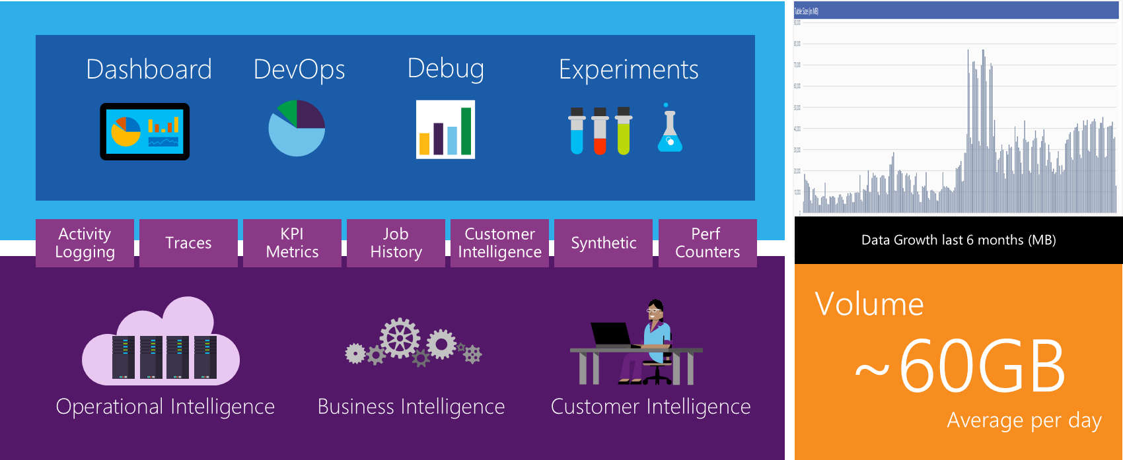
We collect everything!

Slide 59
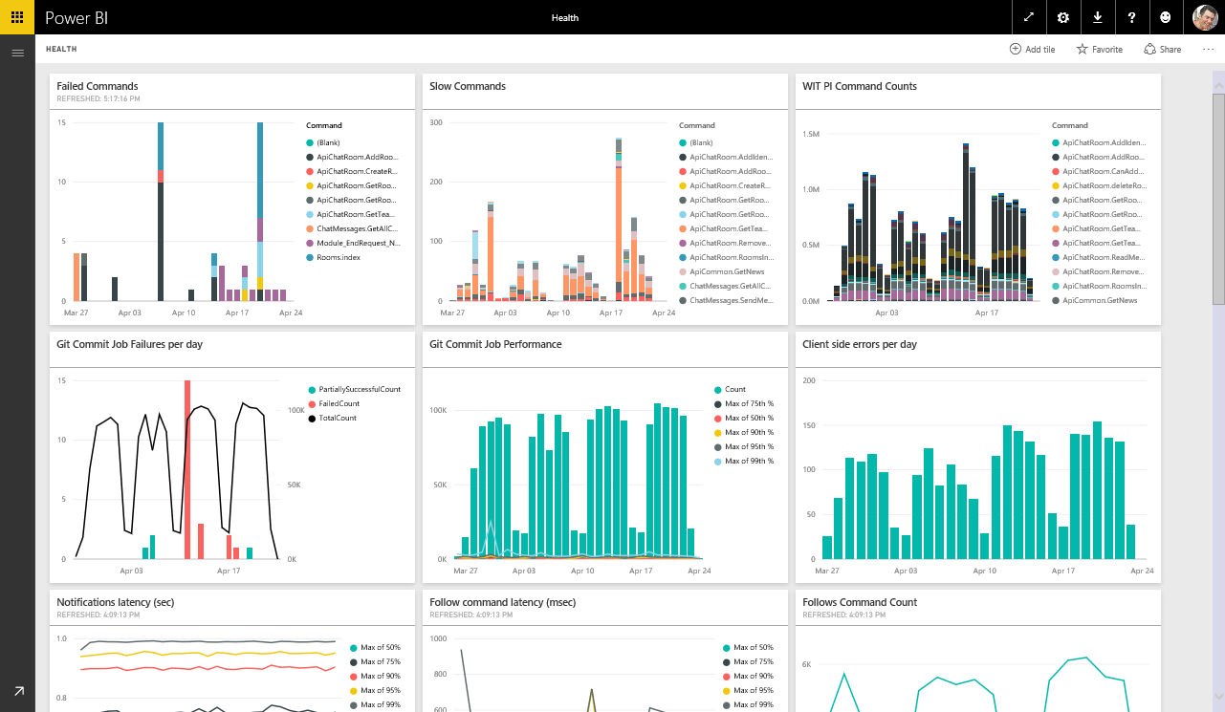
Team dashboard

Slide 60

Build-Measure-Learn
Hypothesis
We believe {customer segment} wants {product/feature} because {value prop}
Experiment
To prove or disprove the above, the team will conduct the following experiment(s): …
Learning
The above experiment(s) prove(s) the hypothesis by impacting the following metric(s): …

Slide 61
Before
Code
Test & Stabilize
Code
Test & Stabilize

Slide 62



After

Slide 63
Take-a-ways
1
Get good at the science… but don’t be overly prescriptive.
2
Don’t copy … learn from others.
3
Build the culture you want… and you’ll get the behavior you’re after.

Slide 64
Thank you
Ewald Hofman
Senior Program Manager
Microsoft
E-mail: Ewald.Hofman@microsoft.com
Twitter: @VSTeam
Survey: http://aka.ms/vstsmeetups

